Slide 1
Introduction to javascript
SALMAN AHMED G

Slide 2
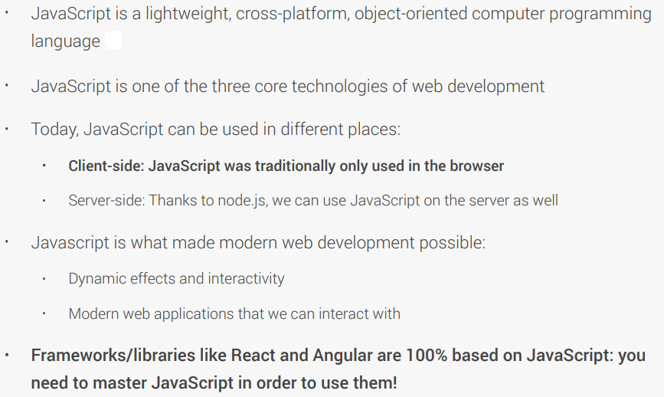
WHAT IS JAVASCRIPT

Slide 3
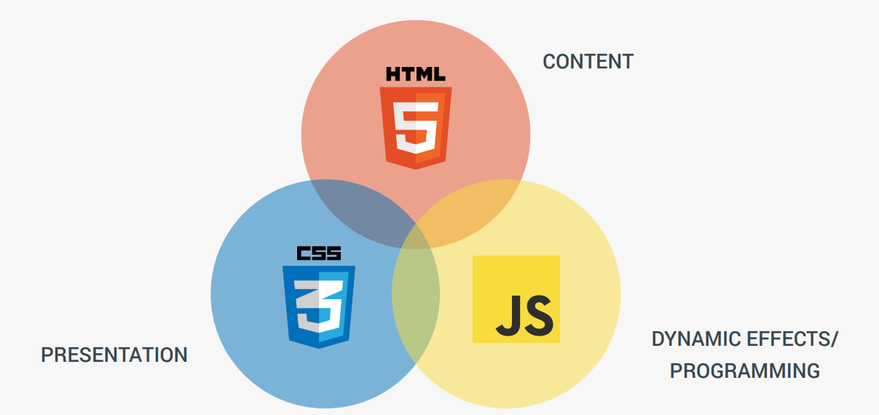
features

Slide 4
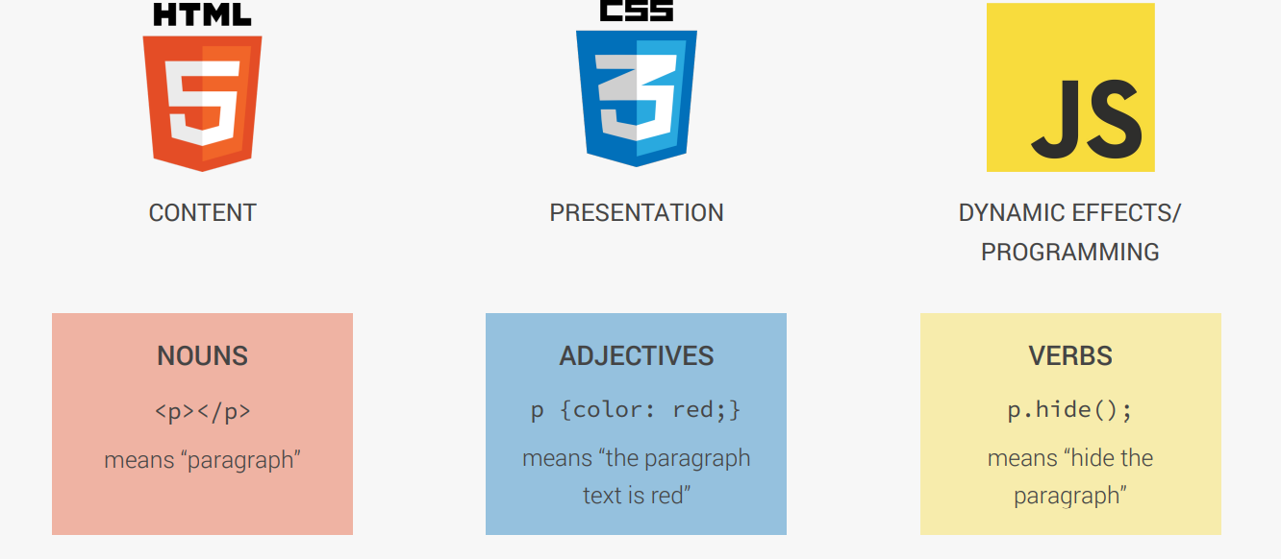
understanding

Slide 5
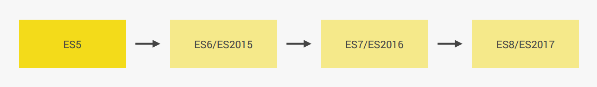
version

Slide 6
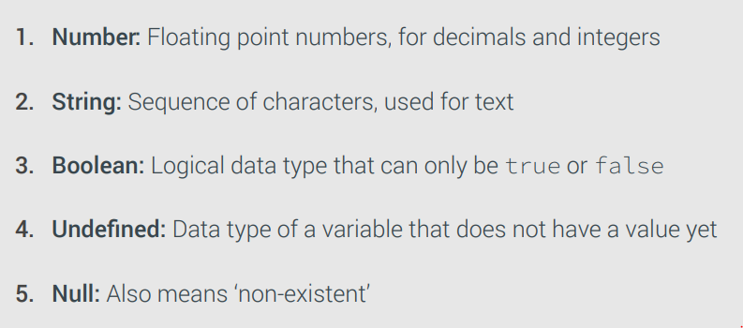
datatypes

Slide 7
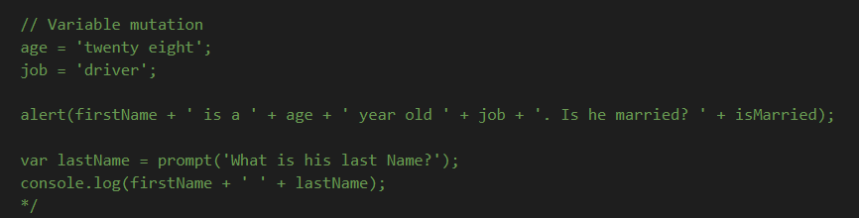
Variable mutation

Slide 8
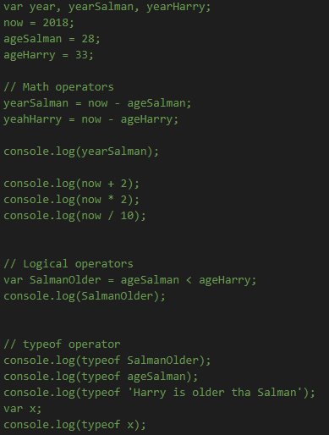
Basic operator

Slide 9
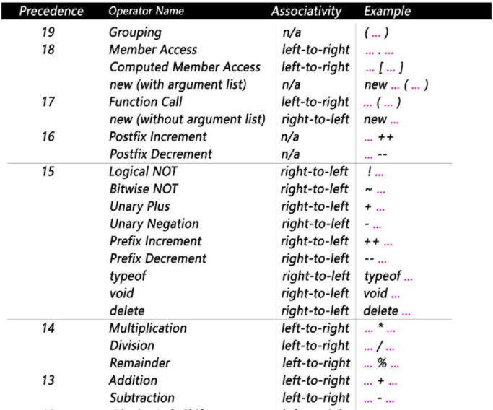
Operator precedence

Slide 10
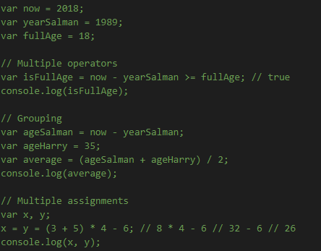
Operator precedence example

Slide 11
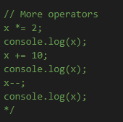
Shorthand operator

Slide 12
Problem statement
Harry and Salman are trying to compare their BMI (Body Mass Index), which is calculated using the formula:
BMI = mass / height^2 = mass / (height * height). (mass in kg and height in meter).
1. Store Harry's and Salman's mass and height in variables
2. Calculate both their BMIs
3. Create a boolean variable containing information about whether Harry has a higher BMI than Salman.
4. Print a string to the console containing the variable from step 3. (Something like "Is Harry's BMI higher than Salman's? true").

Slide 13
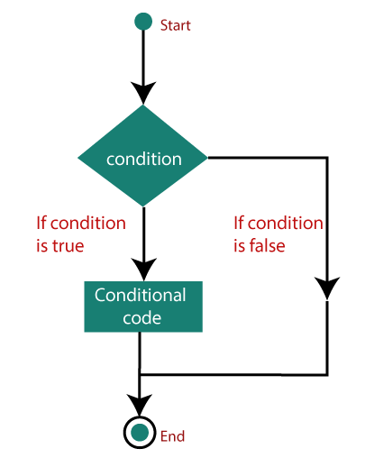
Decision making statement-ifelse

Slide 14
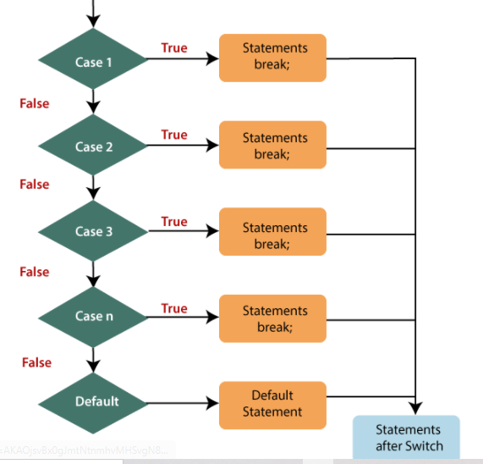
Decision making statement-switch

Slide 15
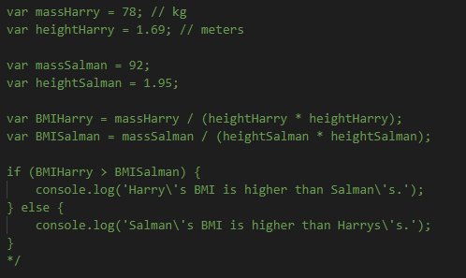
If else - example

Slide 16
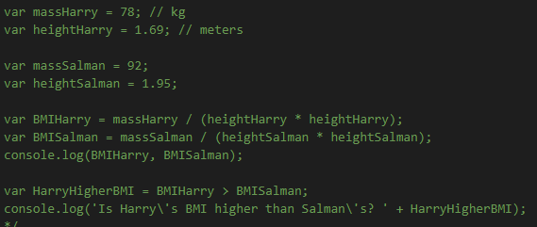
Comparing the problem statement solution

Slide 17
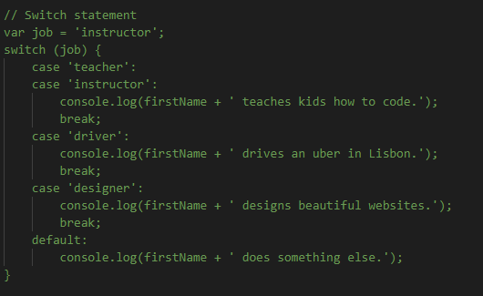
Switch statement - example

Slide 18
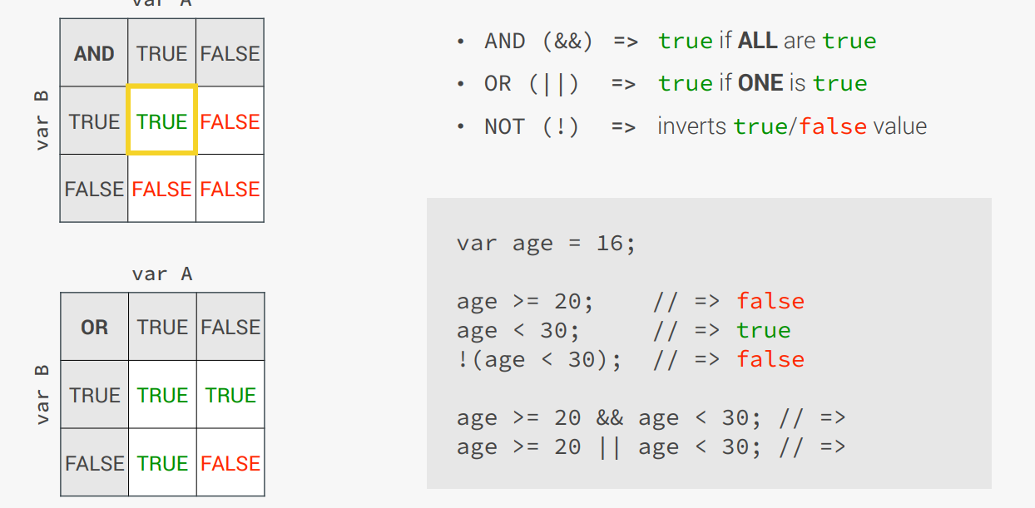
Boolean logic

Slide 19
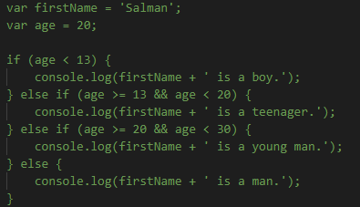
Boolean logic example

Slide 20
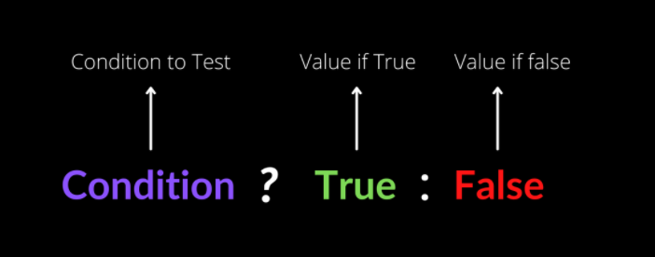
Ternary operator

Slide 21
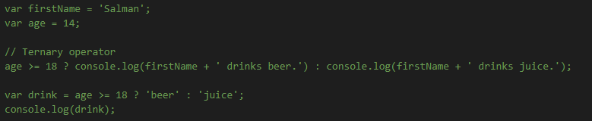
Ternary operator example

Slide 22
Problem statement
Salman and Mike both play basketball in different teams. In the latest 3 games, Salman's team scored 89, 120 and 103 points,
while Mike's team scored 116, 94 and 123 points.
1. Calculate the average score for each team
2. Decide which teams wins in average (highest average score), and print the winner to the console.
Also include the average score in the output.
3. Then change the scores to show different winners. Don't forget to take into account there might be a draw (the same average score)
4. EXTRA: Mary also plays basketball, and her team scored 97, 134 and 105 points.
Like before, log the average winner to the console. HINT: you will need the && operator to take the decision. If you can't solve this one, just watch the solution, it's no problem :)
5. Like before, change the scores to generate different winners, keeping in mind there might be draws.

Slide 23
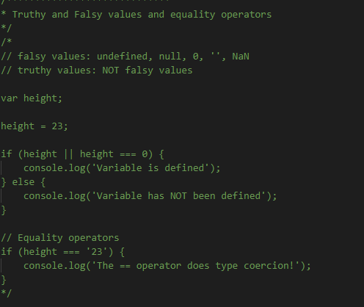
Tips

Slide 24
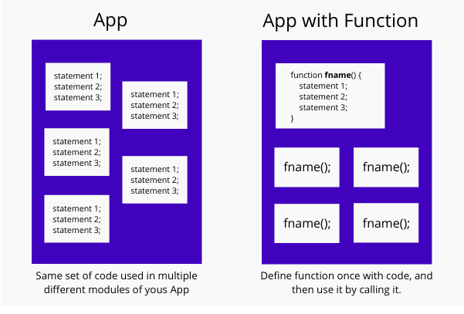
function

Slide 25
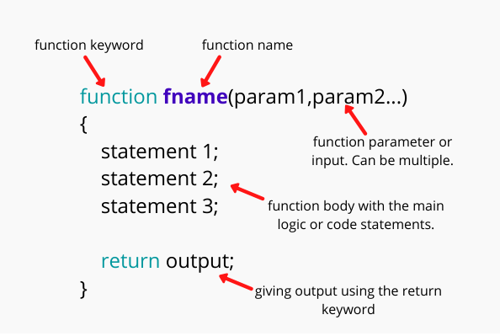
Function statement

Slide 26
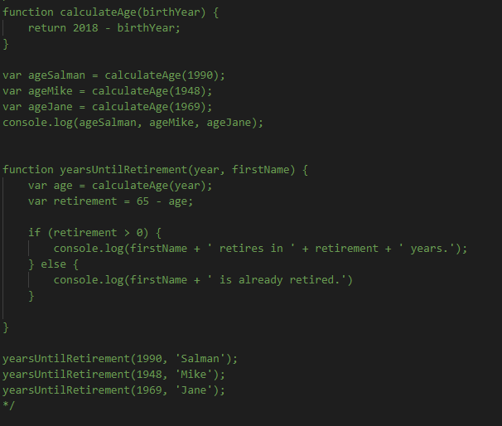
Function - example

Slide 27
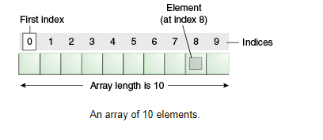
What is array

Slide 28
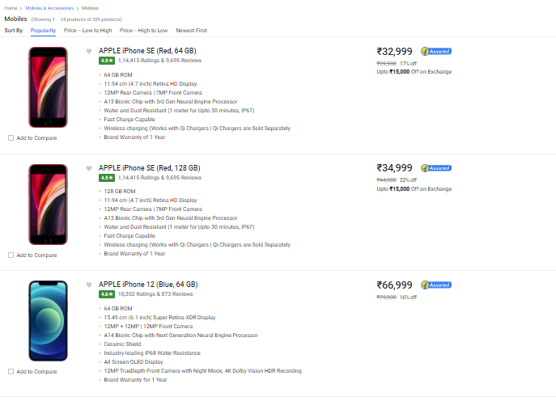
Real world problem- ecommerce

Slide 29
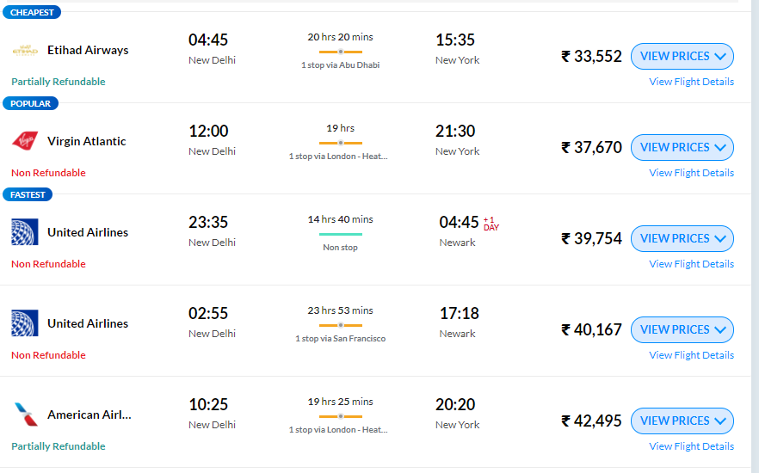
Real world problem - transport

Slide 30
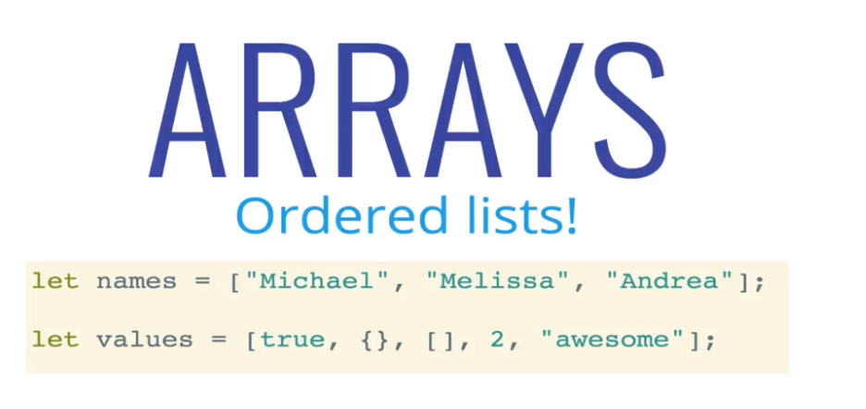
What is array

Slide 31
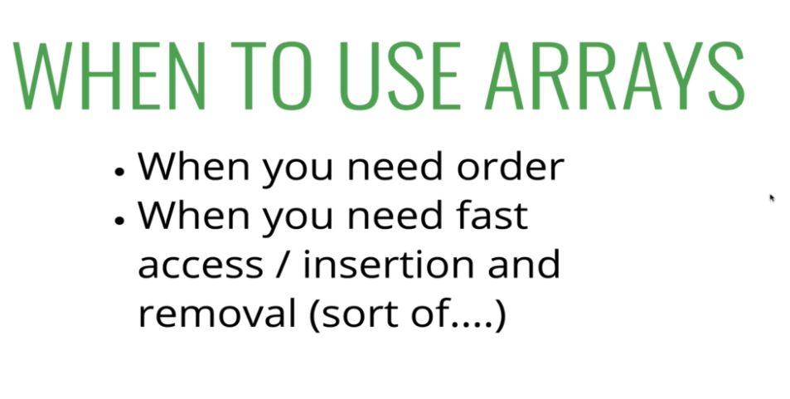
Array?

Slide 32
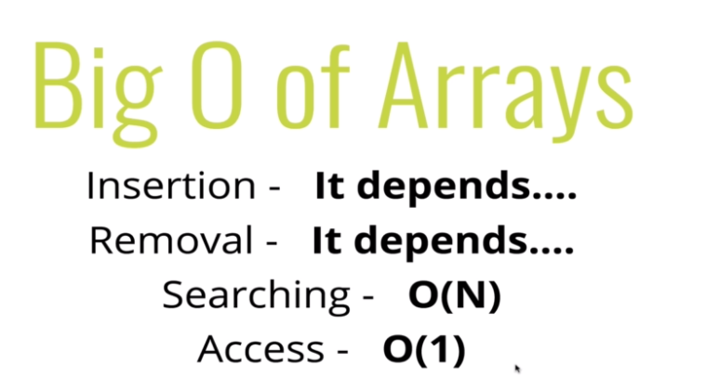
Space and time complexity

Slide 33
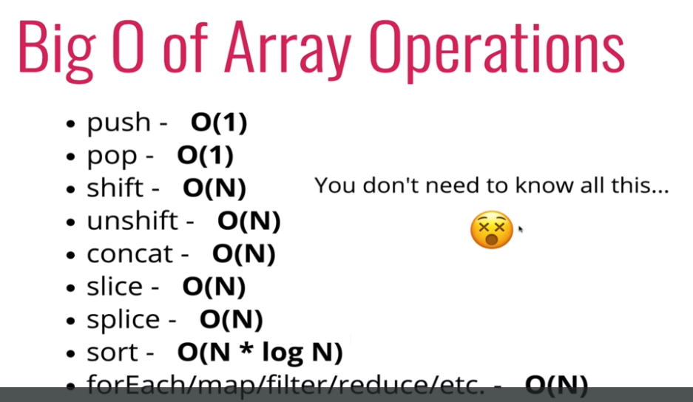
Built in function complexity

Slide 34
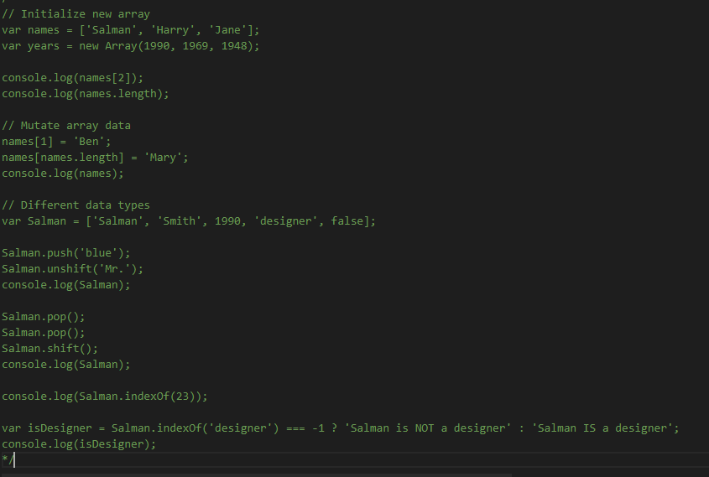
Example of array

Slide 35
Problem statement
Salman and his family went on a holiday and went to 3 different restaurants. The bills were $124, $48 and $268.
To tip the waiter a fair amount, Salman created a simple tip calculator (as a function).
He likes to tip 20% of the bill when the bill is less than $50, 15%
when the bill is between $50 and $200, and 10% if the bill is more than $200.
In the end, Salman would like to have 2 arrays:
1) Containing all three tips (one for each bill)
2) Containing all three final paid amounts (bill + tip).
(NOTE: To calculate 20% of a value, simply multiply it with 20/100 = 0.2)

Slide 36
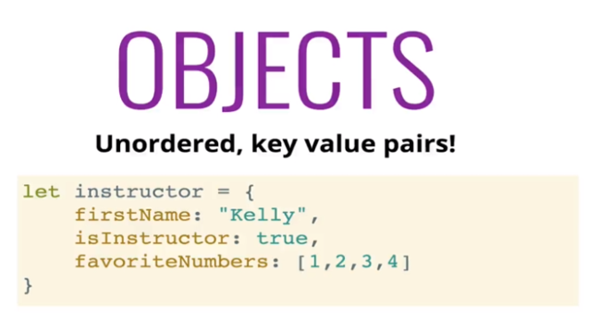
What is object

Slide 37
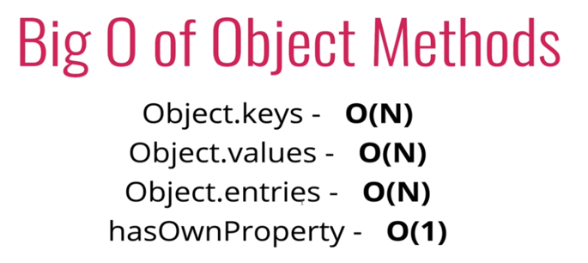
Time and space complexity

Slide 38
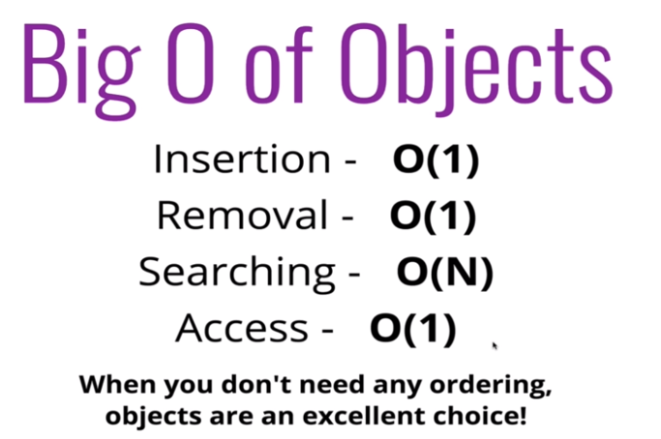
When to use it?

Slide 39
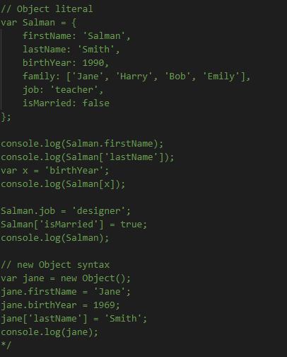
Example:

Slide 40
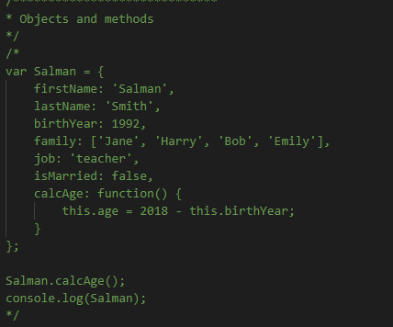
Objects and methods

Slide 41
Problem statement
Let's remember the first coding challenge where Harry and Salman compared their BMIs.
Let's now implement the same functionality with objects and methods.
1. For each of them, create an object with properties for their full name, mass, and height
2. Then, add a method to each object to calculate the BMI. Save the BMI to the object and also return it from the method.
3. In the end, log to the console who has the highest BMI, together with the full name and the respective BMI.
Don't forget they might have the same BMI.
Remember: BMI = mass / height^2 = mass / (height * height). (mass in kg and height in meter).

Slide 42
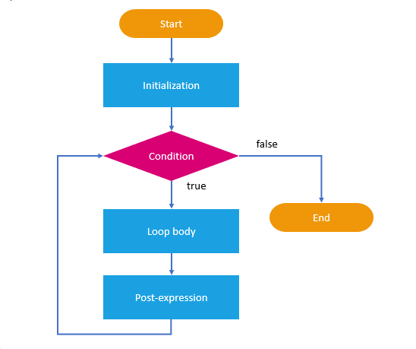
Loops and iteration

Slide 43
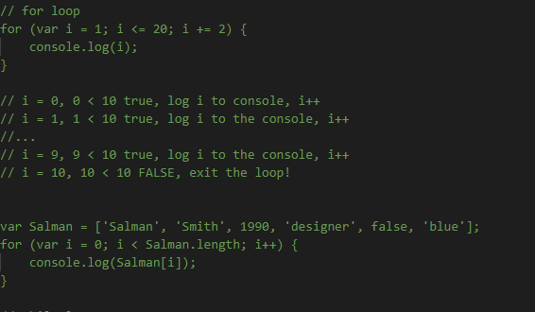
For loop

Slide 44
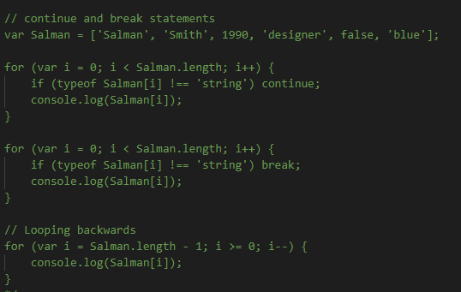
Continue and break statement

Slide 45
Problem statement
Remember the tip calculator challenge? Let's create a more advanced version using everything we learned!
This time, Salman and his family went to 5 different restaurants. The bills were $124, $48, $268, $180 and $42.
Salman likes to tip 20% of the bill when the bill is less than $50, 15% when the bill is between $50 and $200,
and 10% if the bill is more than $200.
Implement a tip calculator using objects and loops:
1. Create an object with an array for the bill values
2. Add a method to calculate the tip
3. This method should include a loop to iterate over all the paid bills and do the tip calculations
4. As an output, create 1) a new array containing all tips, and 2) an array containing final paid amounts (bill + tip).
HINT: Start with two empty arrays [] as properties and then fill them up in the loop.

